Slide 1
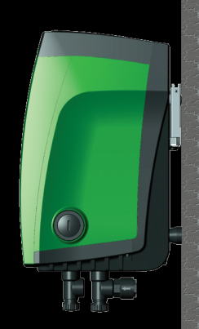
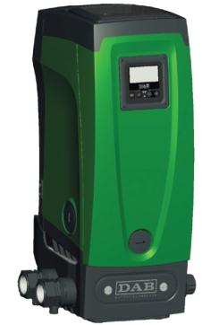
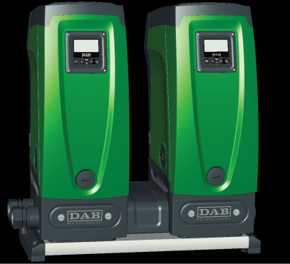
ACCESSORIES & KIT

Slide 2
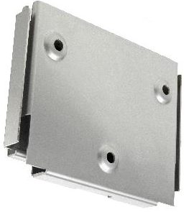
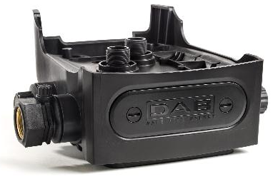
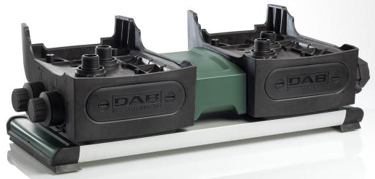
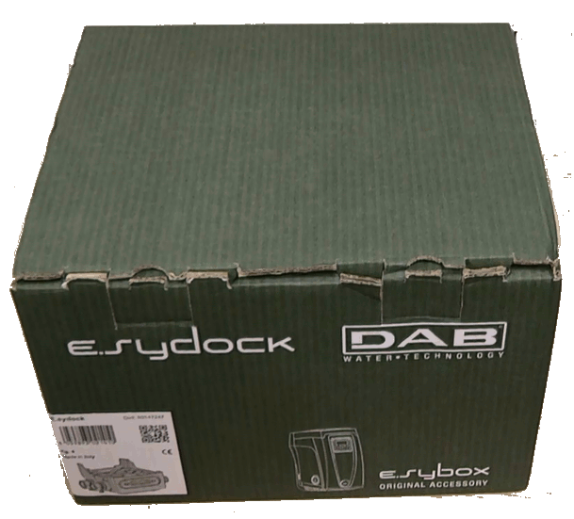
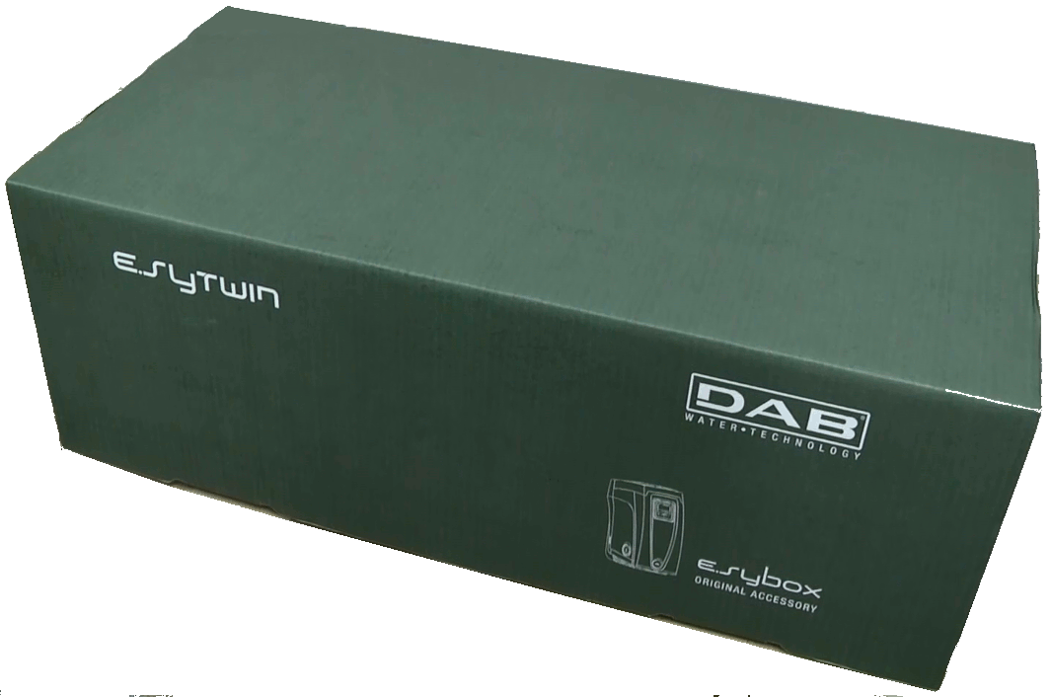
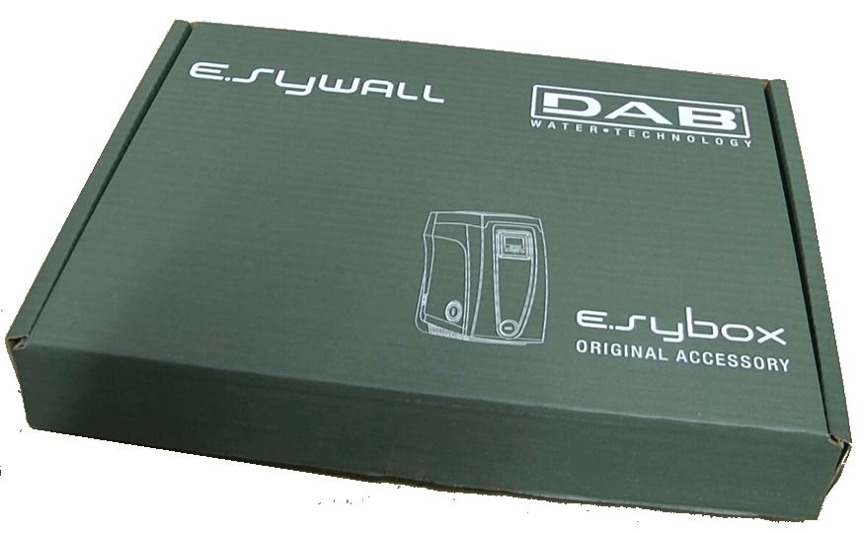
Availability
November 2013

Slide 3
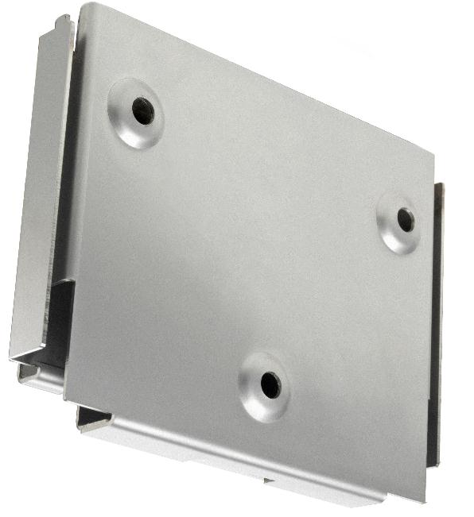
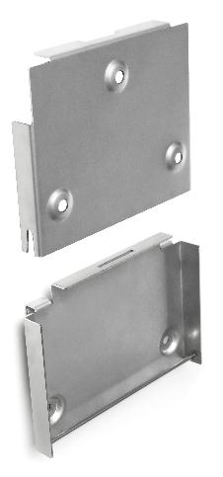
e.sywall – bracket for wall installation

Slide 4
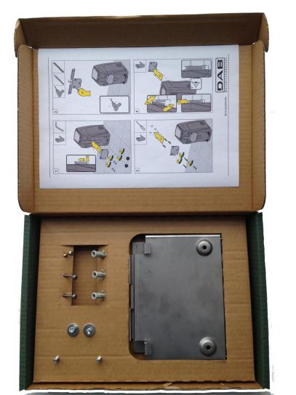
e.sywall – bracket for wall installation
e.sybox is already set up for installation hanging on the wall with the DAB accessory kit e.sywall.
Advantages:
Saving space on the ground
Possibility to simultaneously connect 2 different deliveries in vertical position

Slide 5
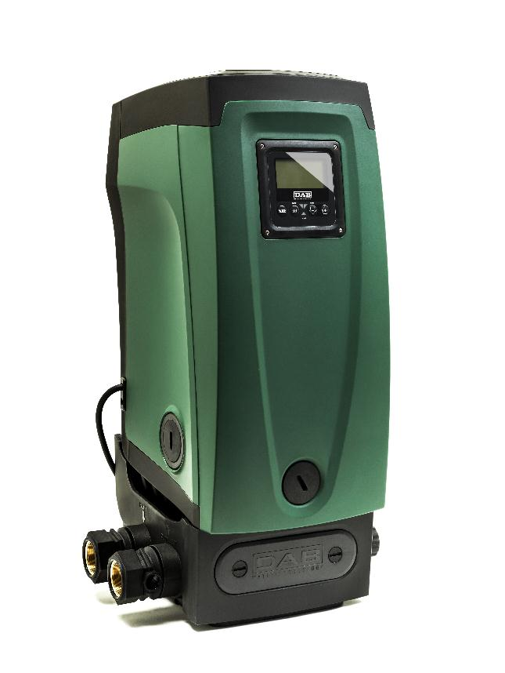
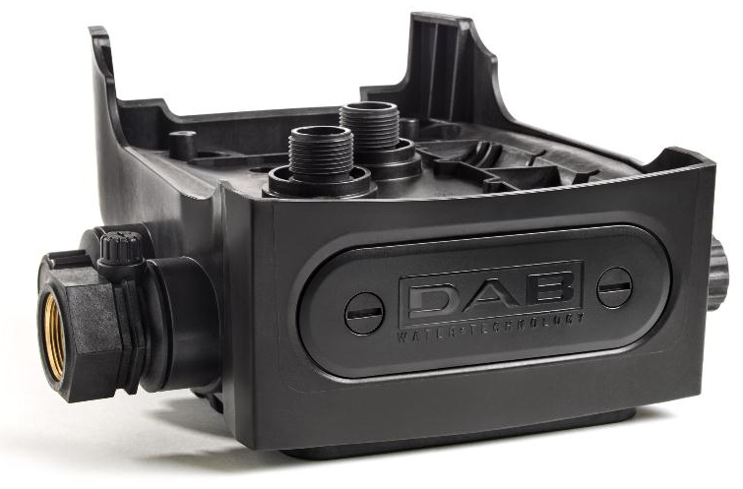
e.sydock – fast connection tool kit
Notes:
5
5

Slide 6
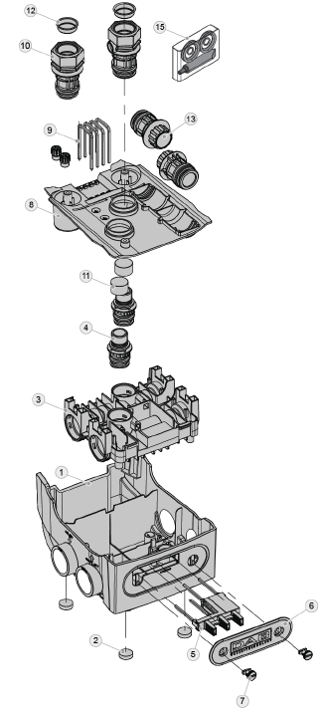
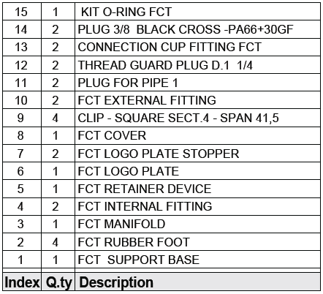
e.sydock – fast connection tool kit
Accessory kit for Quick Connection of the system. This is a quick coupling base on which to make the connections to the plant and from which the system can be simply connected or disconnected.
Advantages:
possibility of making up the plant on-site, testing it, but removing the actual system until the moment of delivery, avoiding possible damage
it is easy for the assistance service to replace the system with a “spare” in the event of special maintenance
Notes:
6
6

Slide 7
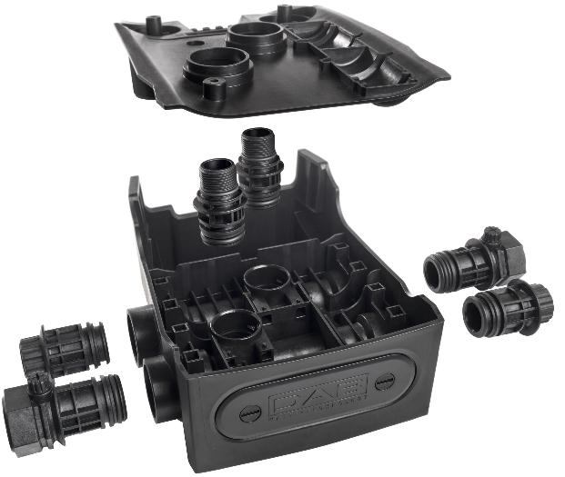
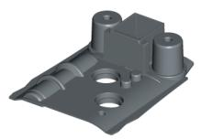
e.sydock – connection features
2 adapters:
to connect the e.sybox
2 suction and delivery union
2 side plugs
4 Clammers: to fasten the union + side plugs
1 upper covers

Slide 8
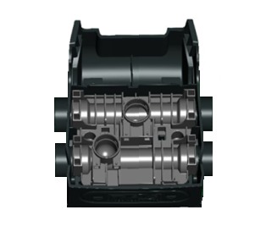
e.sydock – suction and delivery on one side
Right Suction and Delivery
Suction
Closed Side
Delivery
FRONT
Left Suction and Delivery
Suction
Closed Side
Delivery
FRONT

Slide 9
e.sydock – suction and delivery in line
Left Suction, Right Delivery
Suction
Closed Side
Closed Side
Delivery
FRONT
Right Suction, Left Delivery
Closed Side
Suction
Delivery
Closed Side
FRONT

Slide 10
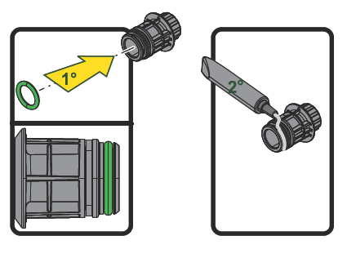
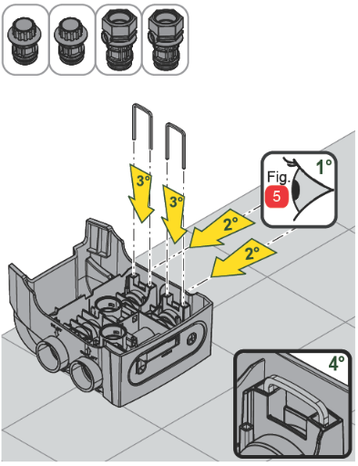
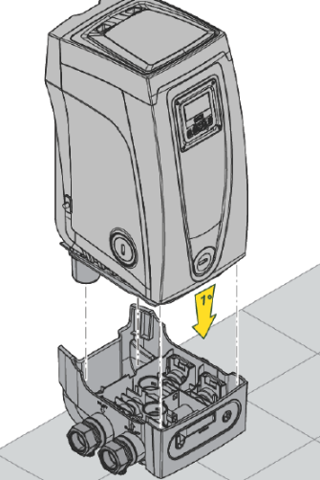
e.sydock – hydraulic connection fixing
WARNING:
Use the quick guide during the installation
Pay attention on the correct position of all o-rings
Grease all o-rings before placing them

Slide 11
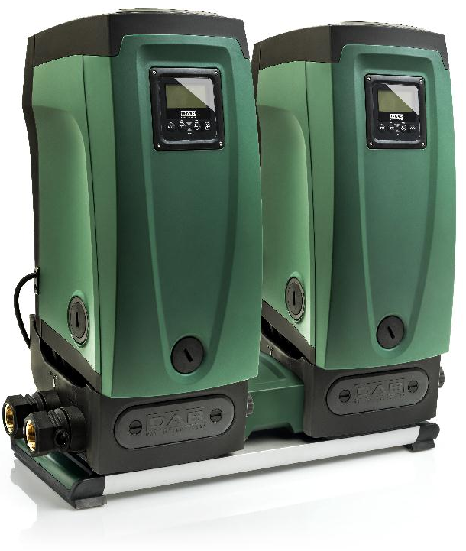
e.sytwin – booster set

Slide 12
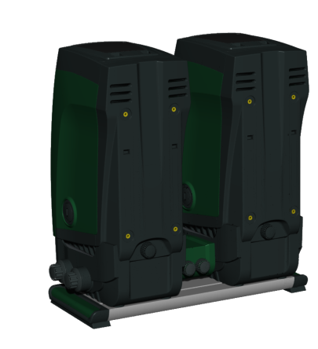
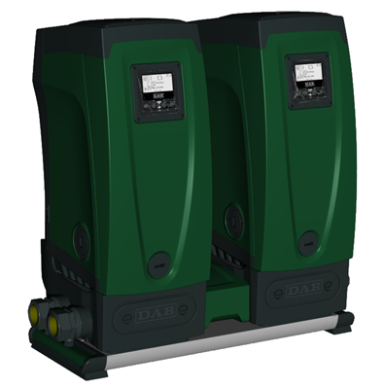
e.sytwin – booster set
Pump set made up of two pumps whose deliveries all flow into a common manifold (pumps in parallel).
Advantages:
Increasing hydraulic performance in comparison with a single device
Ensuring continuity of operation in the event of a device developing a fault
Sharing out the maximum power
Wireless communication:
Modules communicate each other without any cable, just using the wireless connection unit placed on the inverter.

Slide 13
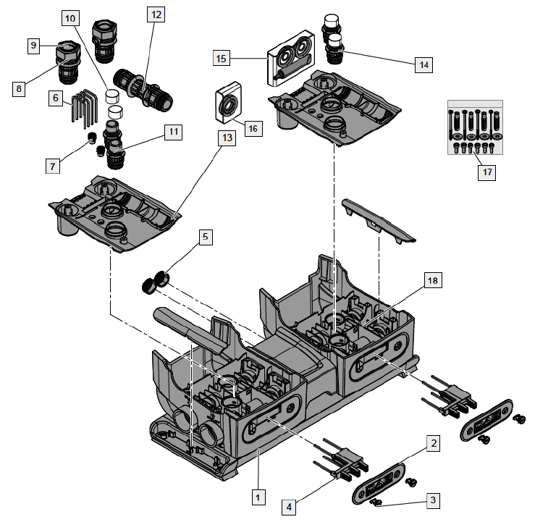
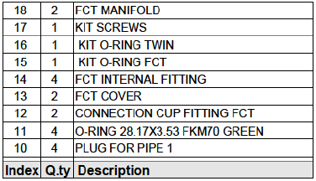
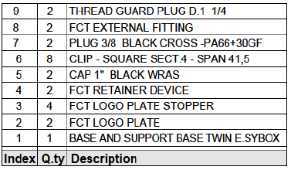
e.sytwin – booster set

Slide 14
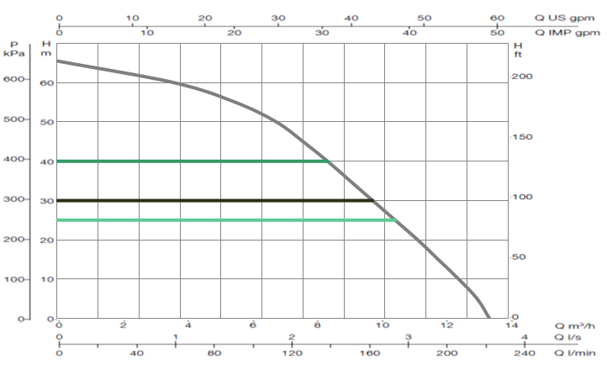
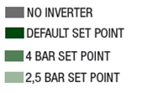
e.sytwin – performance
2 Pump Full Speed
Performance curves of the complete e.sytwin unit including all the connections
(for vessel, heat sink, inverter controllers, check valve, flow and pressure sensors)

Slide 15
e.sytwin – energy saving
2200 Watt at 4 bar 1860 Watt at 3 bar 1800 Watt at 2,5 bar with 8 X Open (96 l/min)
2 Pump Full Speed
Thanks to the Inverter technology, e.sybox draws only the necessary energy according to water requirements, thereby avoiding wastes and allowing considerable economic savings.
ENERGY SAVING AREA

Slide 16
e.sytwin – energy saving
3190 Watt at 4 bar 2800 Watt at 3 bar 2440 Watt at 2,5 bar with 4 X Open (160 l/min)
2 Pump Full Speed
Thanks to the Inverter technology, e.sybox draws only the necessary energy according to water requirements, thereby avoiding wastes and allowing considerable economic savings.
ENERGY SAVING AREA

Slide 17
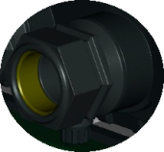
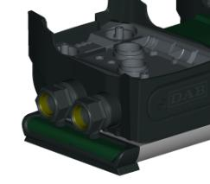
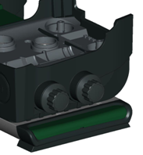
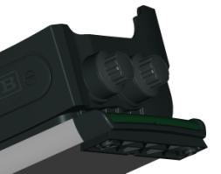
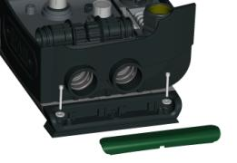
e.sytwin – features
Delivery & Suction Unions
Caps to discharge the system in case of maintenance/removal of the e.sybox
Side caps
Ground Fixing System
Anti Vibration Feet

Slide 18
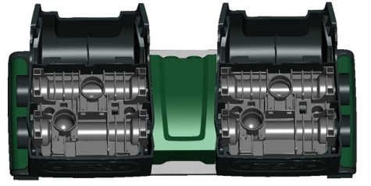
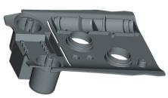
e.sytwin – connection features
4 adapters: to connect 2 e.sybox
2 suction and delivery union
4 Clammers: to fasten the union + side plugs
4 Clammers: To fix the central junction.
2 side plugs
2 maintenance plugs: see next slide
2 upper covers

Slide 19
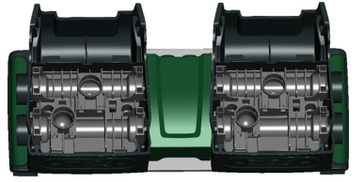
e.sytwin – suction and delivery on one side
Right Suction and Delivery
Suction
Closed Side
Delivery
FRONT
Left Suction and Delivery
Suction
Closed Side
Delivery
FRONT

Slide 20
e.sytwin – suction and delivery in line
Left Suction, Right Delivery
Suction
Closed Side
Closed Side
Delivery
FRONT
Right Suction, Left Delivery
Closed Side
Suction
Delivery
Closed Side
FRONT

Slide 21
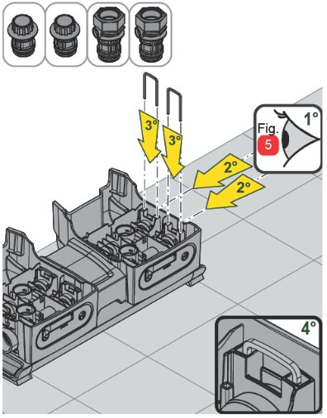
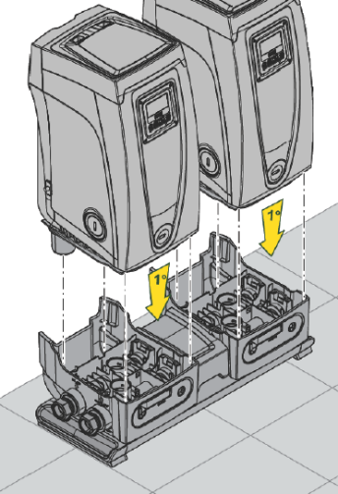
e.sytwin – hydraulic connection fixing
WARNING:
Use the quick guide during the installation
Pay attention on the correct position of all o-rings
Grease all o-rings before placing them

Slide 22
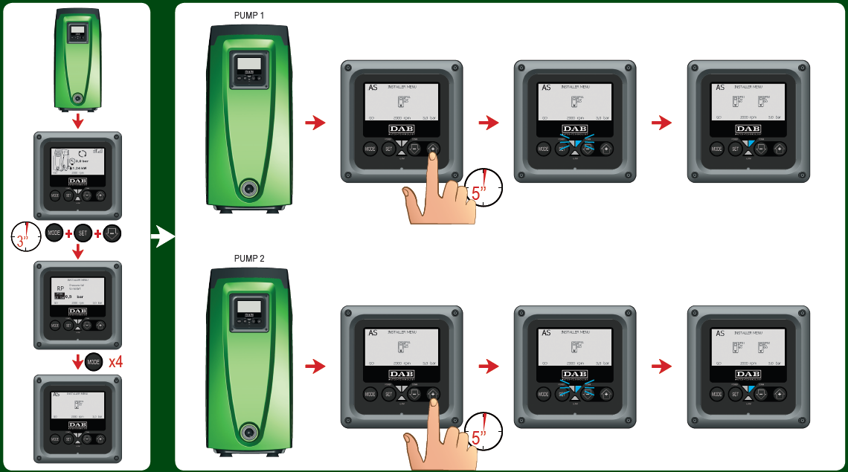
e.sytwin – wireless connection
NO CABLE INTERCONNECTION BETWEEN E.SYBOX

Slide 23
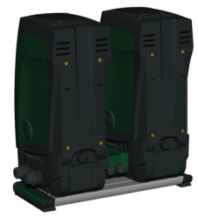
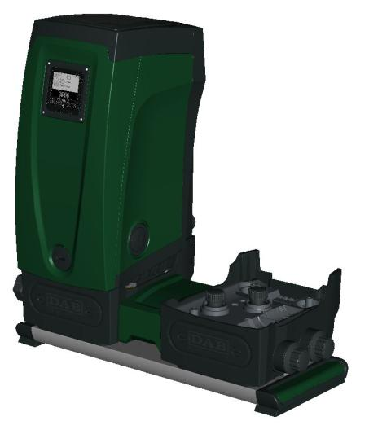
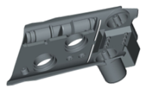
e.sytwin – connection features
It’s possible to disconnect one e.sybox ensuring the water supply thanks to the remaining e.sybox (left pic.).
After disconnecting one unit, fix the adapters and the upper cover to the base. Then screw the 2 maintenenace plugs to the adapters.

Slide 24
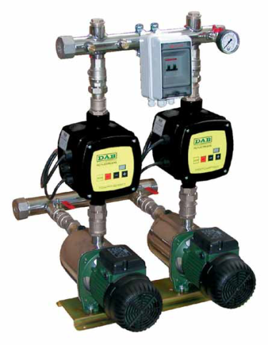
e.sytwin – compact
882
710
540
750
755
350
TOTAL VOLUME ≈ 360 dm³
Pressure vassel not included
TOTAL VOLUME ≈ 190 dm³
- 50% of occupied space

Slide 25
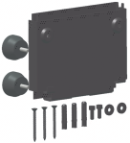
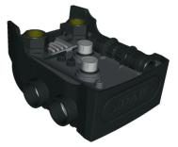
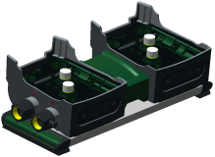
e.sybox accessories – code & dimensions
 | Code | Dimensions [mm] | Dimensions with e.sybox [mm]
 | 60161442 | 185L x 25P x 144H | -
 | GAS – 60147247 | 293L x 318P x 180H | 293L x 345P x 679H (with 1 e.sybox installed)
 | NPT – 60150514
 | GAS – 60160491 | 752L x 358P x 230H | 752L x 358P x 730H (with 2 e.sybox installed)
 | NPT – 60162081
* e.sybox not included (to order : cod. 60147200 )

Slide 26
THANK YOU FOR YOUR ATTENTION

